Slide 1
PROJECT TITLE
CAPSTONE PROJECT
Presented By:
John Alosiyas G (2021311019)
B.Tech Petroleum and Technology
ACTech Anna University

Slide 2
OUTLINE
Problem Statement
Proposed System/Solution
System Development Approach
Algorithm & Deployment
Result
Conclusion
Future Scope
References

Slide 3
Problem Statement
The current manual billing process causes delays for customers and inefficiencies for the organization, presenting an opportunity for improvement. Implementing a computer-based billing system could optimize resource allocation. This system allows for streamlined entry of client, employee, and payment information, enhancing record management and meeting various organizational data requirements. Key drawbacks of the current system include:-
Limited ability to modify data-
Dependence on manual operator oversight
Excessive paper usage
Difficulty in accessing information promptly
Challenges in maintaining systematic records
Paper waste

Slide 4
Proposed Solution
The Restaurant Management System (RMS) is a computerized solution designed to streamline the billing process in a restaurant. With its intuitive interface, the RMS efficiently manages customer billing, allowing for quick transactions. The system can store a significant amount of data and can instantly generate customer bills. Additionally, it provides access to billing history, reservation details, and staff information
As a desktop-based software, RMS is designed to be user-friendly and straightforward, focusing on efficient information management related to staff, billing, and reservation records. It can automatically calculate customer bills and apply discounts, reducing the need for manual paperwork. Data is entered directly into the system, allowing for easy generation of various bills. Since all information is stored in a secure database, there's no risk of data loss, and the reliance on physical paperwork is minimized. Overall, the system simplifies restaurant operations by reducing the need for manual record-keeping, making processes more efficient and organized.

Slide 5
System Approach
Creating a restaurant management system in Python follows a structured process, comprising the following stages:
Understanding Requirements:
Start by comprehensively analyzing the system's requirements, covering menu management, order processing, reservations, inventory management, and reporting.
2. Modular Organization:
Structure the system into separate modules, each focusing on specific functions like Menu Management, Order Processing, Reservation Handling, Inventory Management, and Reporting.
Class Definition:
Define classes within each module to represent entities and actions. These classes could include Menu Items, Orders, Reservations, and Inventory Items.
4. Establishing Relationships:
Define connections between classes/modules to illustrate how they interact. For example, determine how orders relate to menu items and how inventory levels are influenced by orders.

Slide 6
System Approach
5. Functionality Implementation:
Develop methods and functions within each class/module to execute required tasks, such as updating menus, processing orders, managing inventory, and handling reservations.
6. Optional User Interface:
Depending on needs, create a user interface, such as a command-line interface, a graphical interface using libraries like Tkinter or PyQt, or a web-based interface with Flask or Django.
7. Testing and Refinement:
Conduct thorough testing to ensure the system functions correctly and meets requirements. Refine the system based on testing feedback and results.
Documentation:
Document the system's design, functionalities, and usage instructions to facilitate future maintenance and support. This documentation serves as a valuable resource for developers and users alike.

Slide 7
Algorithm & Deployment
Revamped Structure for Restaurant Management:
Efficient Menu Organization:
Develop a structured menu item class capturing vital details like name, price, and description. - Establish a dedicated system for managing menu items, ensuring smooth addition, removal, and display processes.
2. Streamlined Order Processing:
Create a robust order framework, integrating essential elements such as order ID, selected items, and total price. - Implement seamless functionalities for adding items, precise price calculation, and efficient order processing.
Seamless Reservation Handling:
Define a comprehensive reservation structure, encompassing key details like reservation ID, customer name, date, and table allocation. - Design an intuitive reservation management system, enabling easy reservation creation, availability checks, and cancellations.
4. Effective Inventory Management:
Introduce a well-organized inventory framework, highlighting critical attributes like item name, quantity, and price. - Develop efficient inventory management tools for smooth stock addition, dynamic quantity updates, and proactive low stock alerts.

Slide 8
Algorithm & Deployment
Insightful Reporting Mechanisms:
Incorporate advanced reporting functionalities to generate customized reports, including sales and inventory insights tailored to specific user needs.
User-Centric Interface Design:
Craft an intuitive interface to enhance user experience, offering flexible options such as command-line, web-based, or GUI interfaces tailored to user preferences.
Flexible Deployment Strategies:
Explore diverse deployment approaches, including local deployment with PyInstaller, web-based deployment using Flask or Django, mobile app deployment via Kivy or React Native, containerization with Docker, and hybrid deployment for comprehensive coverage.

Slide 9
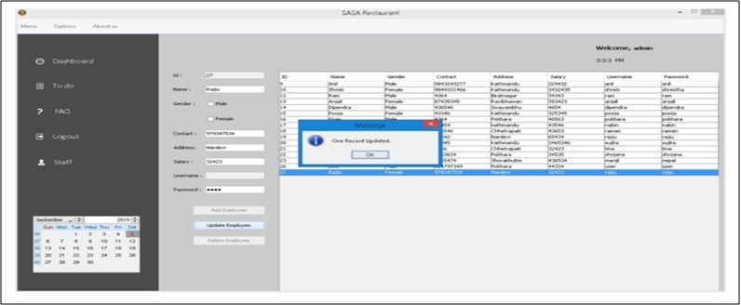
Result
Reviewing the Restaurant Billing System's functionality, it efficiently handles staff data, customer reservations, billing tasks, and more. Upon closer examination, the system demonstrates robust features for managing staff information, such as adding, editing, updating, and deleting records. Additionally, it simplifies reservation procedures, accommodates cancellations, and generates bills for customers. The system's outputs are visually illustrated in the accompanying figure for clarity.

Slide 10
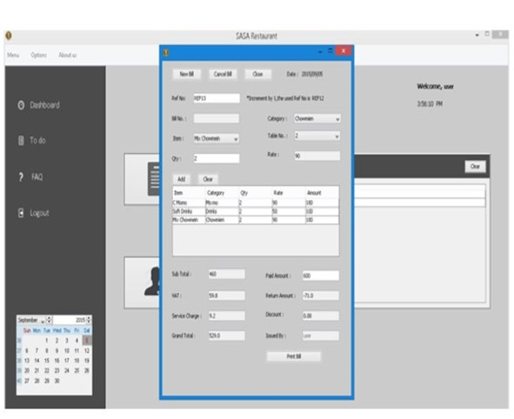
Result

Slide 11
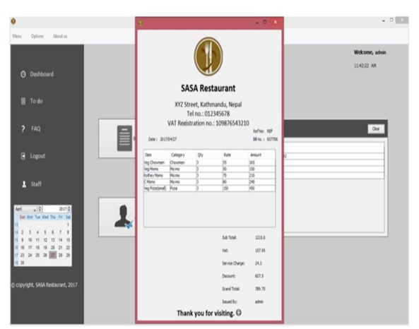
Result

Slide 12
Conclusion
The documentation gives a detailed account of the structure and code of the Restaurant Management system. Building this program was a challenging endeavor that required thorough analysis, extensive research, and a variety of technical skills. Writing this report has been an enlightening experience, showcasing the lessons learned from navigating complex tasks. Developing a system for a restaurant required a mix of research and technical expertise, with achieving a smooth operational flow demanding considerable time and effort.
Despite the challenges, the system was completed with a robust design and smooth workflow. The billing system was the most complex part. Extracting data from the database for billing involved intricate SQL queries and managing multiple database changes, which required a lot of time and careful planning.
Overall, this project provided valuable coding experience and underscored the importance of effective time management and teamwork in software development.

Slide 13
Future scope
The restaurant management software (RMS) is a versatile tool that streamlines various aspects of restaurant operations. It includes functions like staff management, order processing, billing, menu administration, reservation handling, order history tracking, task management, and more. Looking ahead, there's room for continuous improvement and expansion. Enhancements such as advanced inventory management, wireless tableside ordering and payment options, real-time alerts, online ordering integration, and mobile management capabilities offer opportunities for revenue growth and cost savings.

Slide 14
References
Restaurant Billing System:
https://www.scribd.com/doc/283903672/Online-Ordering-System-
Project Objective :
https://www.scribd.com/document/36253350/04-Project-Billing-
System Scopes and Limitation:
https://kungfumas.files.wordpress.com/2017/09/099.pdf
Feasibility study:
http://www.slideshare.net/alok104/synopsis-on-billing-system-27487568
UML Diagram :
https://www.techopedia.com/definition/3243/unified-modeling-language-uml/
Use Case Diagram:
http://whatis.techtarget.com/definition/use-case-diagram
Class Diagram:
http://searchmicroservices.techtarget.com/definition/class-diagram
Sequence Diagram :
https://creately.com/blog/diagrams/sequence-diagram-tutorial/
ER Diagram:
http://searchcrm.techtarget.com/definition/entity-relationship-diagram
Interfaces : https://www.youtube.com/watch?v=9K5sS7j5wWI

Slide 15
THANK YOU

